Slide 1
Развитие критического мышления на уроках английского языка
Цедилин Сергей Игоревич
учитель английского языка
МБОУ СОШ № 5 г. Дубны
г.о Дубна
Московская область

Slide 2
Вызов (evocation)
Осмысление содержания (realization of meaning)
Трёхфазовая модель
Рефлексия (Reflection)

Slide 3
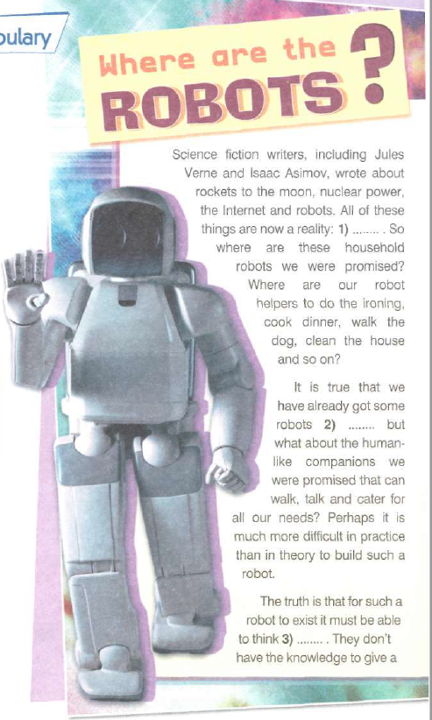
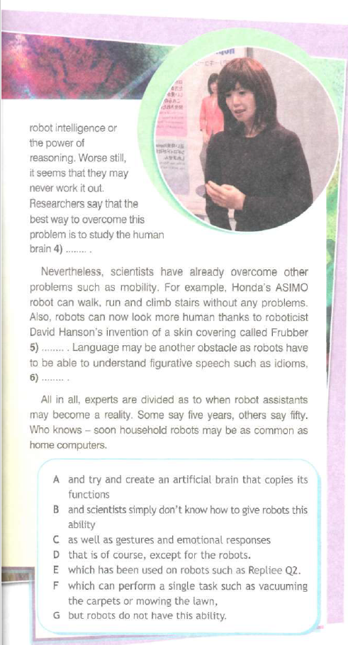
Кластер

Slide 4
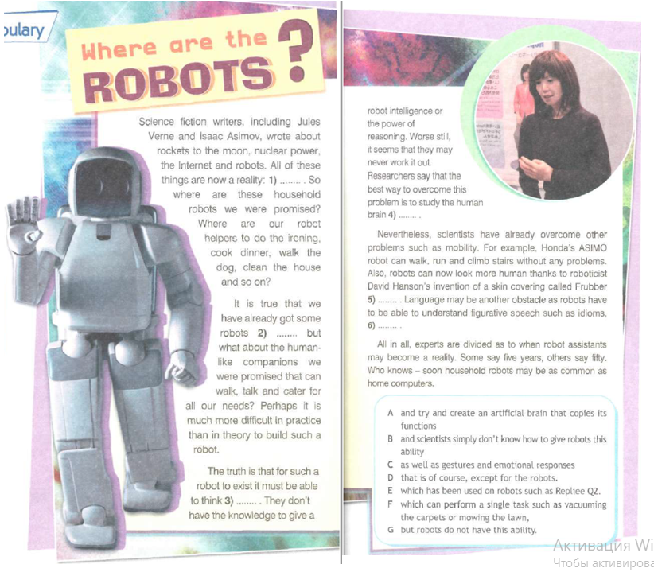
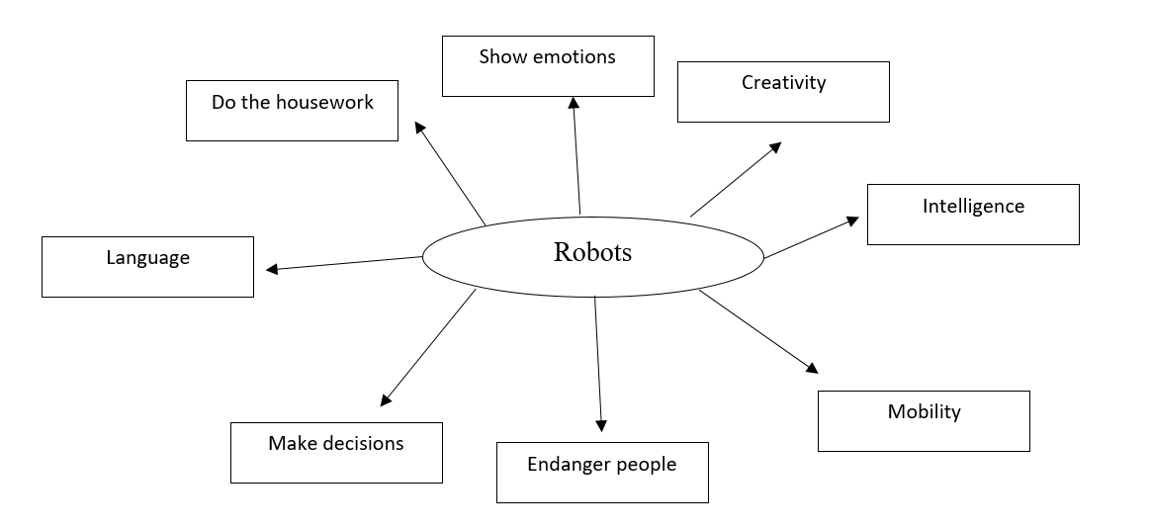
S1: Robots can’t show emotions as they don’t possess a brain or nervous system.
S2: Robots may endanger human beings because they can’t control their actions that can result in bad consequences.
S3: Robots can do some of the household chores such as watering the plants or mopping the floor but they can’t do all the housework.

Slide 5
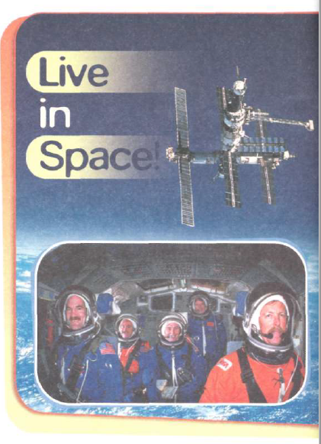
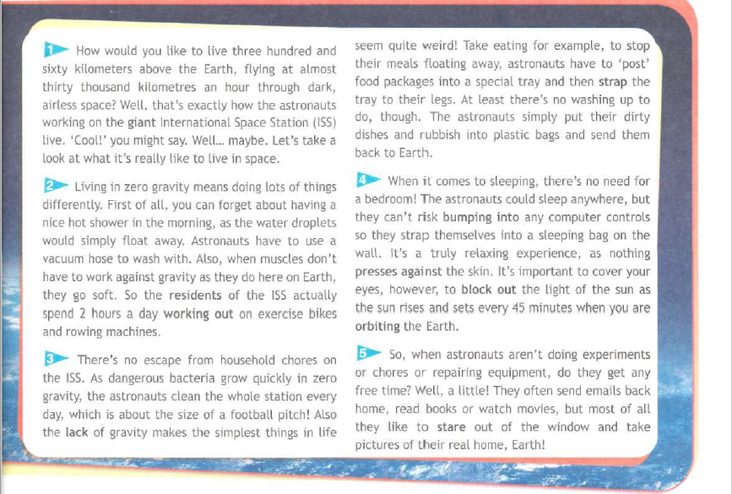
Таблица З-Х-У (Знаю – хочу знать – узнал)

Slide 6
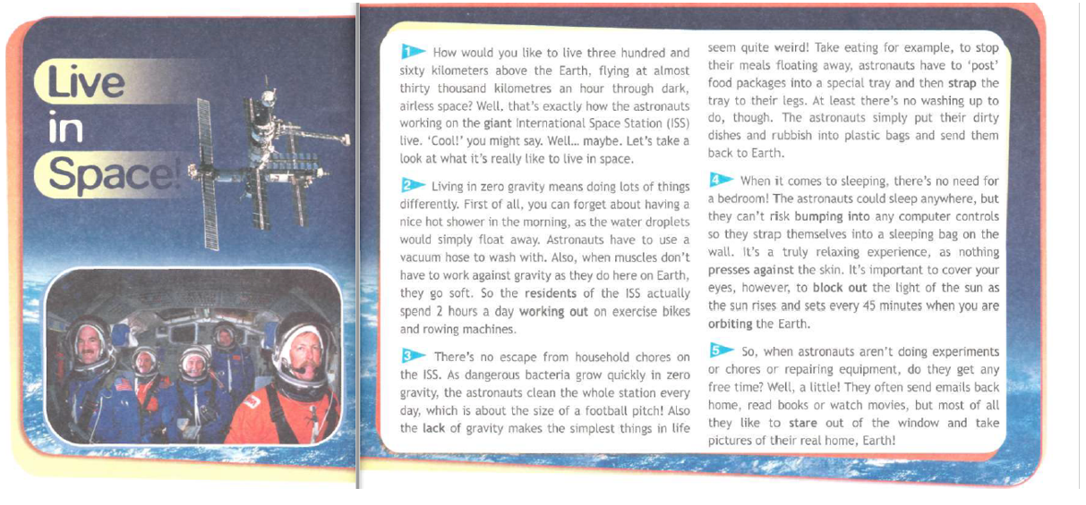

Slide 7
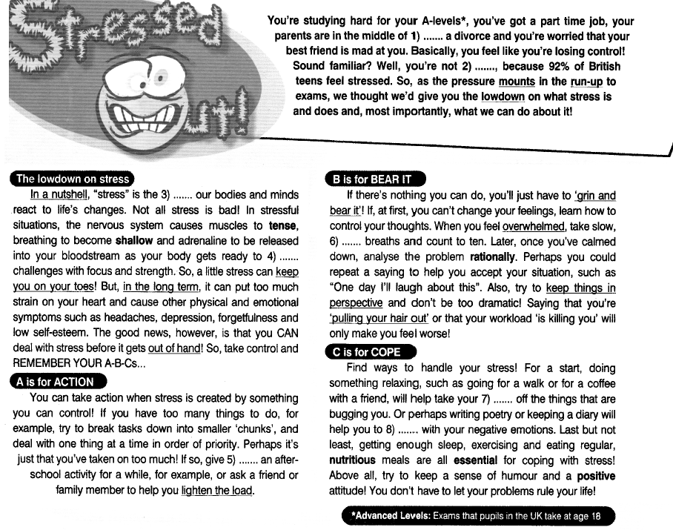
Верные или неверные утверждения

Slide 8
Before
Statements
After
-
+
+
-
People can control their stress
All stress is bad
When you have too many things to do, it’s a good idea to do them all immediately without waiting till the last possible moment
Eating any type of food can help cope with stress

Slide 10
Before
Statements
After
-
+
+
-
People can control their stress
All stress is bad
When you have too many things to do, it’s a good idea to do them all immediately without waiting till the last possible moment
Eating any type of food can help cope with stress
+
-
-
-

Slide 11
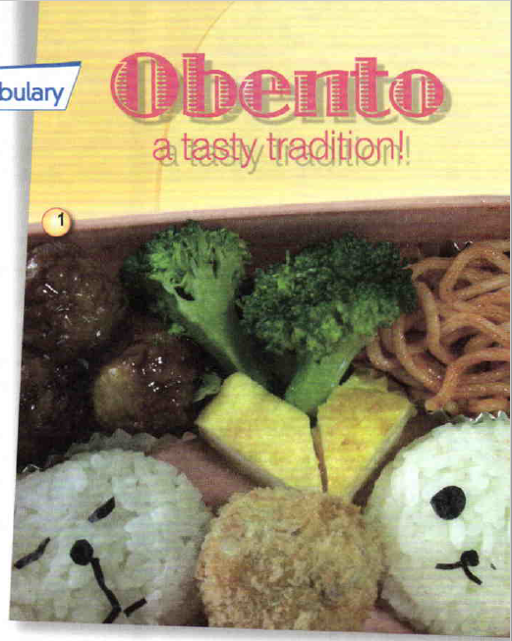
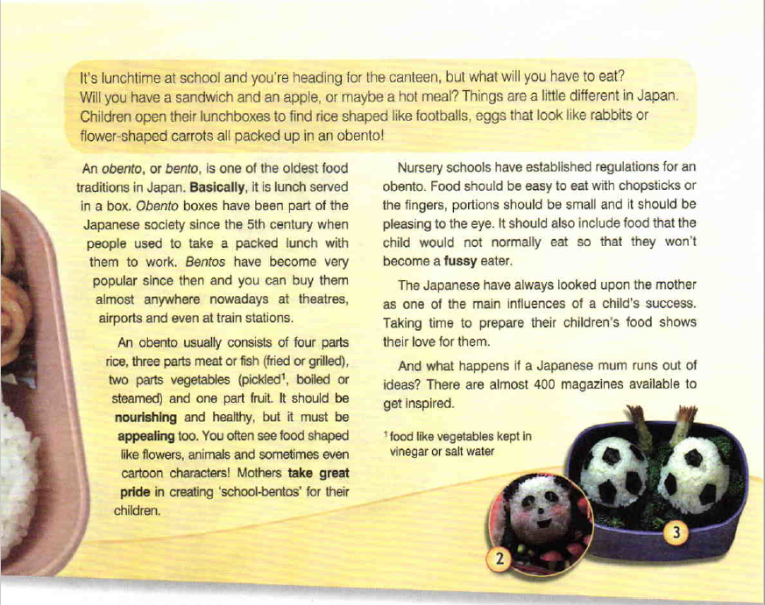
«Тонкие» и «толстые» вопросы

Slide 13
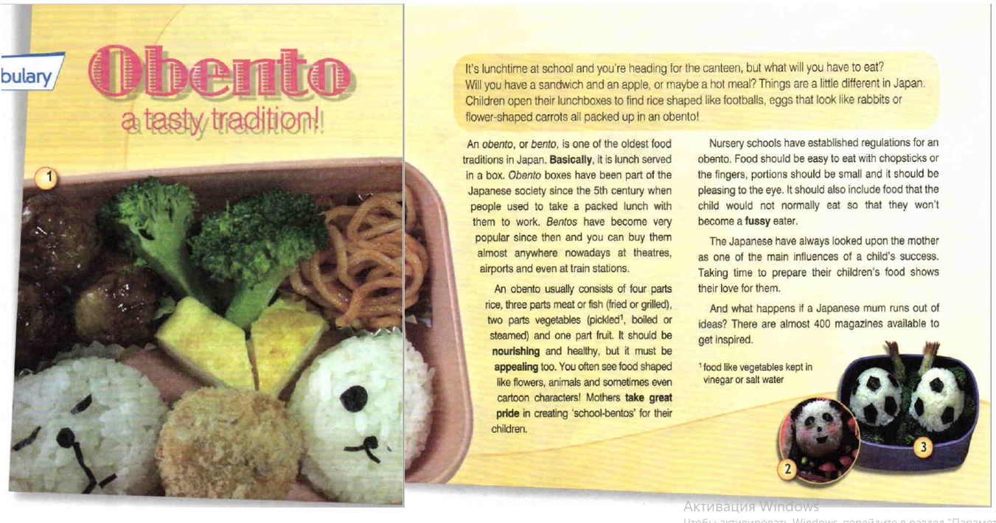
Thin questions:
What is an “obento”?
What does an “obento” consist of?
Where does an “obento” come from?
Where is it possible to buy an “obento”?
Thick questions:
Why is an “obento” so popular?
If you had an opportunity, would you taste an “obento? Why?

Slide 14
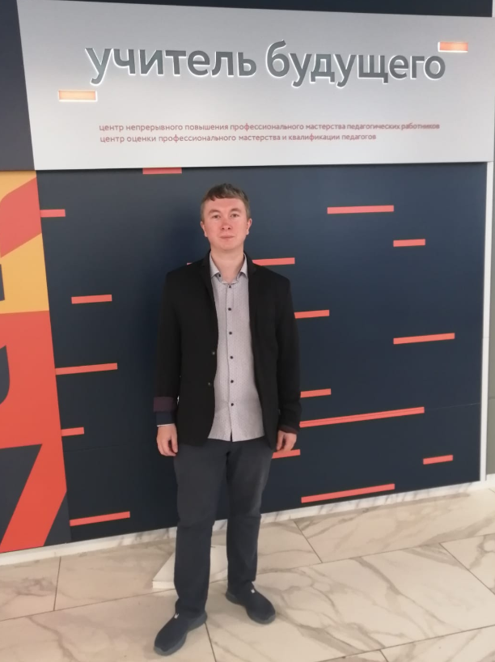
СПАСИБО
ЗА ВНИМАНИЕ!

